Slide 1
Tutorial 5: Data Visualisation

Slide 2
Summary
Analysis of Data-related jobs compared to non-data related jobs among visa applicants in the US based on 2015 data.
Project completed with:
Python Pandas for data manipulation
Excel for visualisations

Slide 3
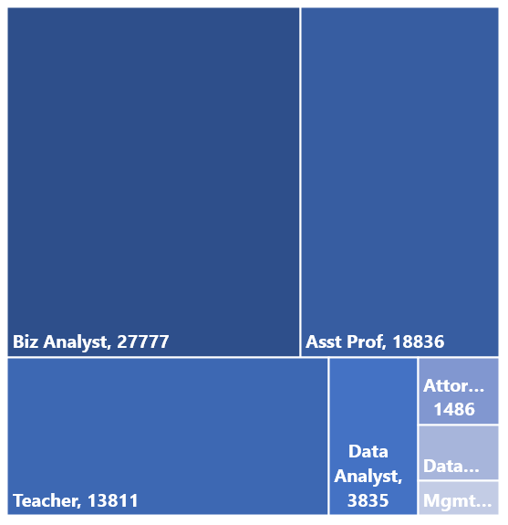
Data Analyst vs Data Scientist Sample Size
Overall job demographic of applicants*
*Excluding 99230 Software Engineers, excluded since it took up
more than half of the chart

Slide 4
Annual Wages by Job and Visa type
Data Analyst
Data Scientist
*There are only 11 H-1B1 Singapore applicants
*There is only 1 person applying for the H-1B1 Chile Visa

Slide 5
Annual Wages Green Card vs Non Green Card
Data Analyst
Data Scientist

Slide 6
Visa Application Success Rate for Data vs Non Data-related Jobs

Slide 7
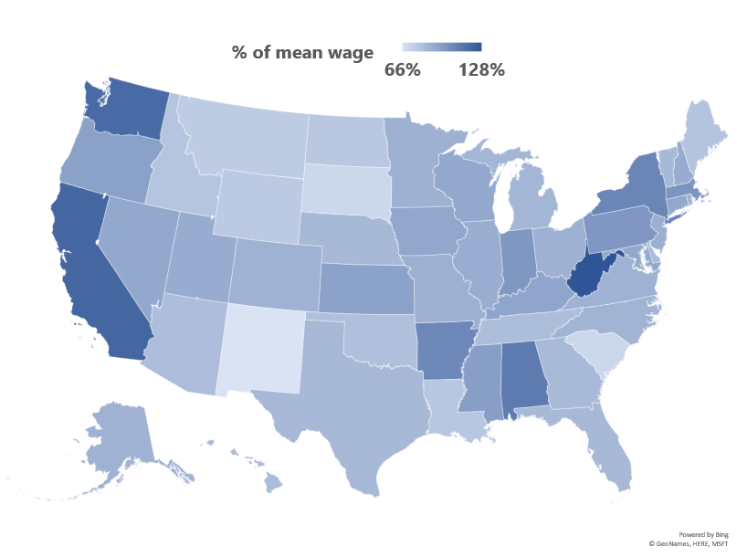
Annual Paid Wages across all States
Average Wage:
US$85,608.56
Visa Applicants from 43 states has a paid wage lower than average paid wage

